Slide 1


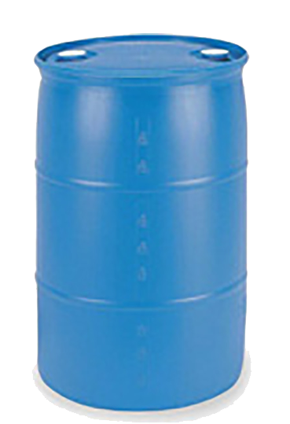


 | Shoot Up Them Magazine Clips (It’s for the children 👶🏻) Course Designer: Kris Erickson |  |  |  |  | Bay 1
"What's the efficacy of banning these magazine clips? I will tell you... these are ammunition, they're bullets. So the people who have those now, they're going to shoot them, so if you ban them in the future, the number of these high capacity magazines is going to decrease dramatically over time because the bullets will have been shot and there won't be any more available." – Rep. Diana DeGette (D-CO). SCENARIO: As a goodwill gesture to Rep. DeGette, let’s shoot up a bunch of our magazine clips so she doesn’t have to worry about them anymore.
START POSITION: Facing T1, toes on marks. PCC START: Facing T1, toes on marks, rifle at low ready. |  | STRINGS | CONCEALMENT |  | SCORING |  | TOTAL ROUNDS
 |  | 1 | REQUIRED |  | UNLIMITED |  | 18
STAGE PROCEDURE: At signal, engage T1 with 4 rounds (moving or stationary). From P1, engage T2–T4 with 2 rounds each. Move to P2, engaging surprise targets T5, T6, and S1 in the open. Engage S2-S4 from cover of P2. |  | TARGETS |  | 6 threat, 1 non-threat, 4 steel.
 |  | SCORED HITS |  | Best 4 on T1, best 2 on T2–T6, steel down.
 |  | NOTES: S1 must be engaged from behind the fault line or else the shooter will be DQed (10 yards). S2-S4 must be engaged from P2 for the same reason.
S1
S2 – S4
T6
T5
T2–T4
P2
T1
START
P1
https://www.youtube.com/watch?v=rT7TOL_V08M

